Slide 1
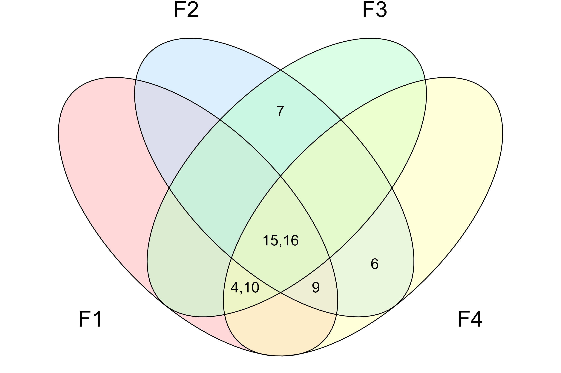
F2 – Networked shocks
F3 – Multilateral governance
A phenomenon underlying the polycrisis is an accumulation of wears and tears.
The polycrisis is here to stay.-
-
The crises are clearly connected.
The polycrisis is the product of human interconnectivity.
The polycrisis concept captures the complexity of the world.
-
A phenomenon underlying the polycrisis is capitalism.
The polycrisis is rooted in a geopolitical order constructed by Western colonialism.
F1 – Capital-rooted interdependence
F4 – Postcolonialism

